Slide 1
A Clustering Analysis of Policing in Chicago
Eric Chandler and Jacob Lehr
Notes:
Jacob

Slide 2
Overview
Background and Overview of Solution
Data
Machine Learning and Details of Solution
Evaluation and Results
Notes:
Jacob

Slide 3
Background and Overview of Solution
Problem:
Reported and actual discrimination in policing
Are there distinct clusters of police activity?
How can we quantify this?
Solution:
ML-based clustering can distinguish between distinct neighborhoods in Chicago that experience different types of policing
This can provide the police, local activists, and reporters with more targeted reforms
Notes:
Jacob

Slide 4
Data
Combine separately generated policing-related datasets:
Name | Source | Time period | Features Used
ISR (Investigatory Stop Report) Data | Chicago Police Department | 2016-2019 | Total number of stops, total number of searches, total number of arrests, total number of stops by race (Black, White, Hispanic)
Use of Force Data | Chicago Police Department | 2016-2019 | Total number of incidents, total number of incidents with/without a police weapon, total number of incidents by race (Black, White, Hispanic)
Complaints | City of Chicago | 2016-2019 | Total number of complaints, total number of police shooting related complaints, total number of complaints by race (Black, White, Hispanic)
Crimes | City of Chicago | 2016-2019 | Total number of crimes, total number of domestic crimes, total number of arrests, total number of crimes by race (Black, White, Hispanic)
Census Demographic Data | U.S. Census Bureau American Community Survey (ACS) | 2018 5-year estimates | Total population, median household income, percent of the total population by race (Black, White, Hispanic)
Notes:
Jacob

Slide 5
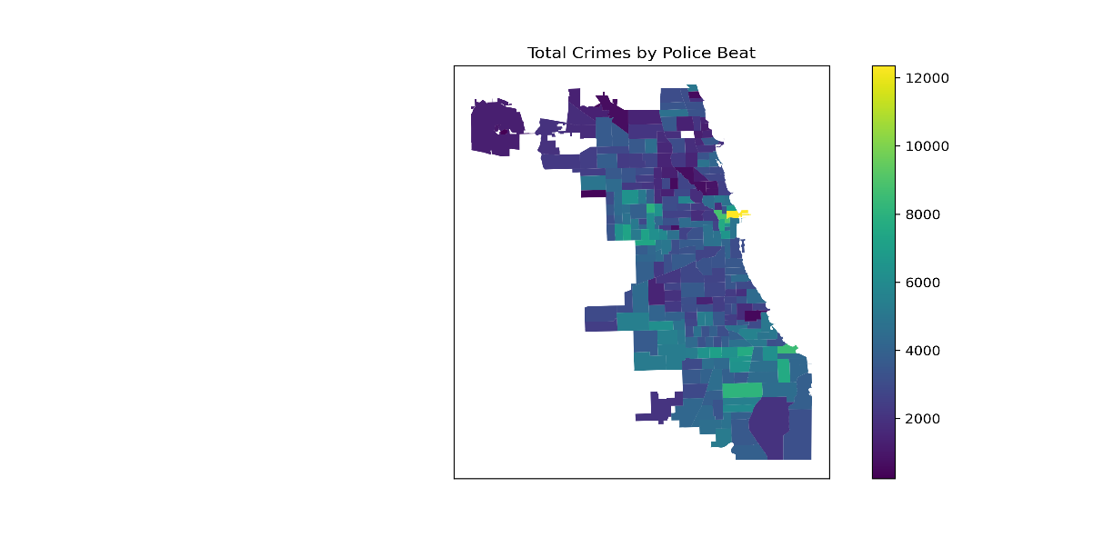
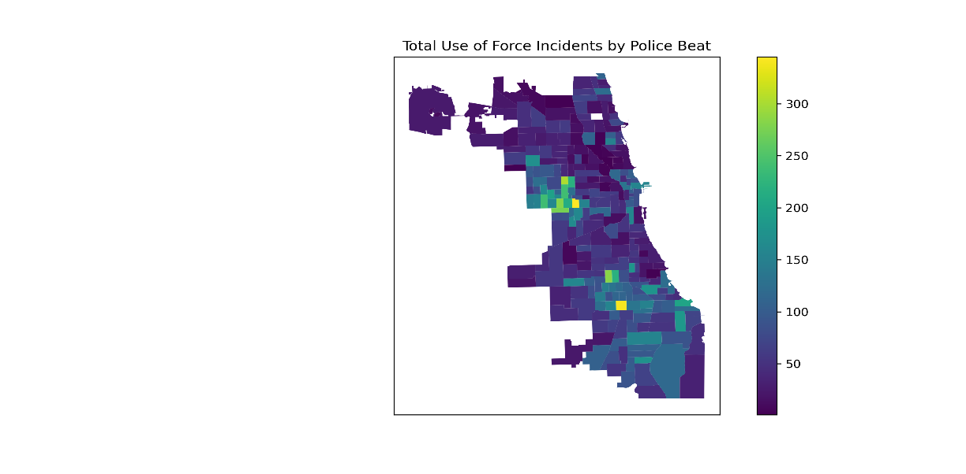

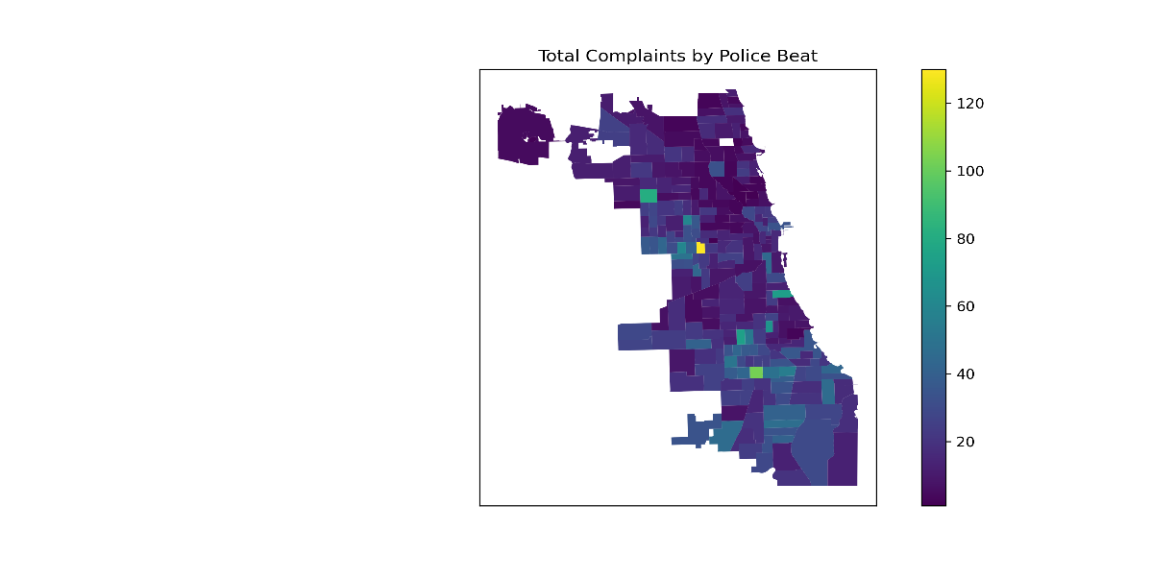
Data Visualization and Exploration
Notes:
Jacob
Some clustering is visible in a 2-D space, but we hope to find more when using the full features in the dataset

Slide 6
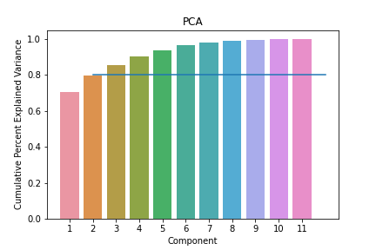
Machine Learning Analysis
Feature engineering
Use raw counts of each activity (stops/crimes/use of force incidents)
Aggregate at police beat / year level
Dimensionality Reduction
Use first 6 PCs in model
Notes:
Eric

Slide 7
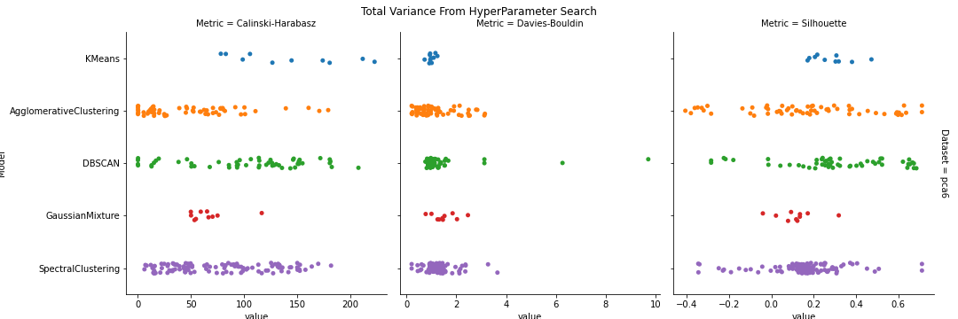
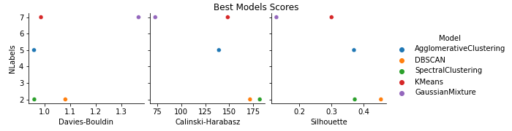
Model Evaluation and Selection
Two step process:
Find best model within each type of clustering model
Find best model across different “best models”
Notes:
Eric

Slide 8
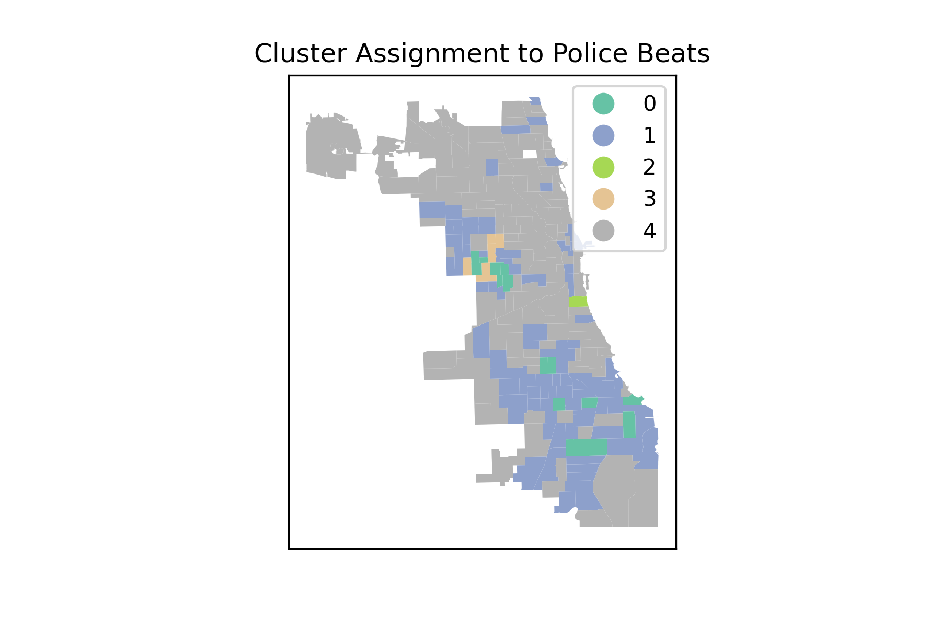
Evaluation and Results
Mean Feature Value (count) per Beat by Cluster
 | Cluster
Feature | 0 | 1 | 2 | 3 | 4
COMPLAINTS_POLICE_SHOOTING | 1 | 0 | 14 | 1 | 0
COMPLAINTS_TOTAL | 52 | 28 | 30 | 47 | 11
CRIME_TOTAL | 6,147 | 4,595 | 3,544 | 7,074 | 2,726
CRIME_ARREST | 1,929 | 997 | 508 | 2,917 | 423
CRIME_DOMESTIC | 1,307 | 875 | 534 | 1,226 | 364
ISR_TOTAL_STOPS | 4,053 | 2,288 | 468 | 5,441 | 936
ISR_SEARCH | 874 | 417 | 51 | 1,378 | 142
ISR_ARREST | 650 | 287 | 40 | 1,208 | 102
UOF_TOTAL_COUNT | 207 | 100 | 54 | 259 | 38
UOF_POLICE_W_WEAPON | 14 | 9 | 4 | 20 | 3
UOF_POLICE_WO_WEAPON | 67 | 32 | 12 | 86 | 11
Note: Shaded columns represent clusters with few beats assigned.
Notes:
Eric

Slide 9
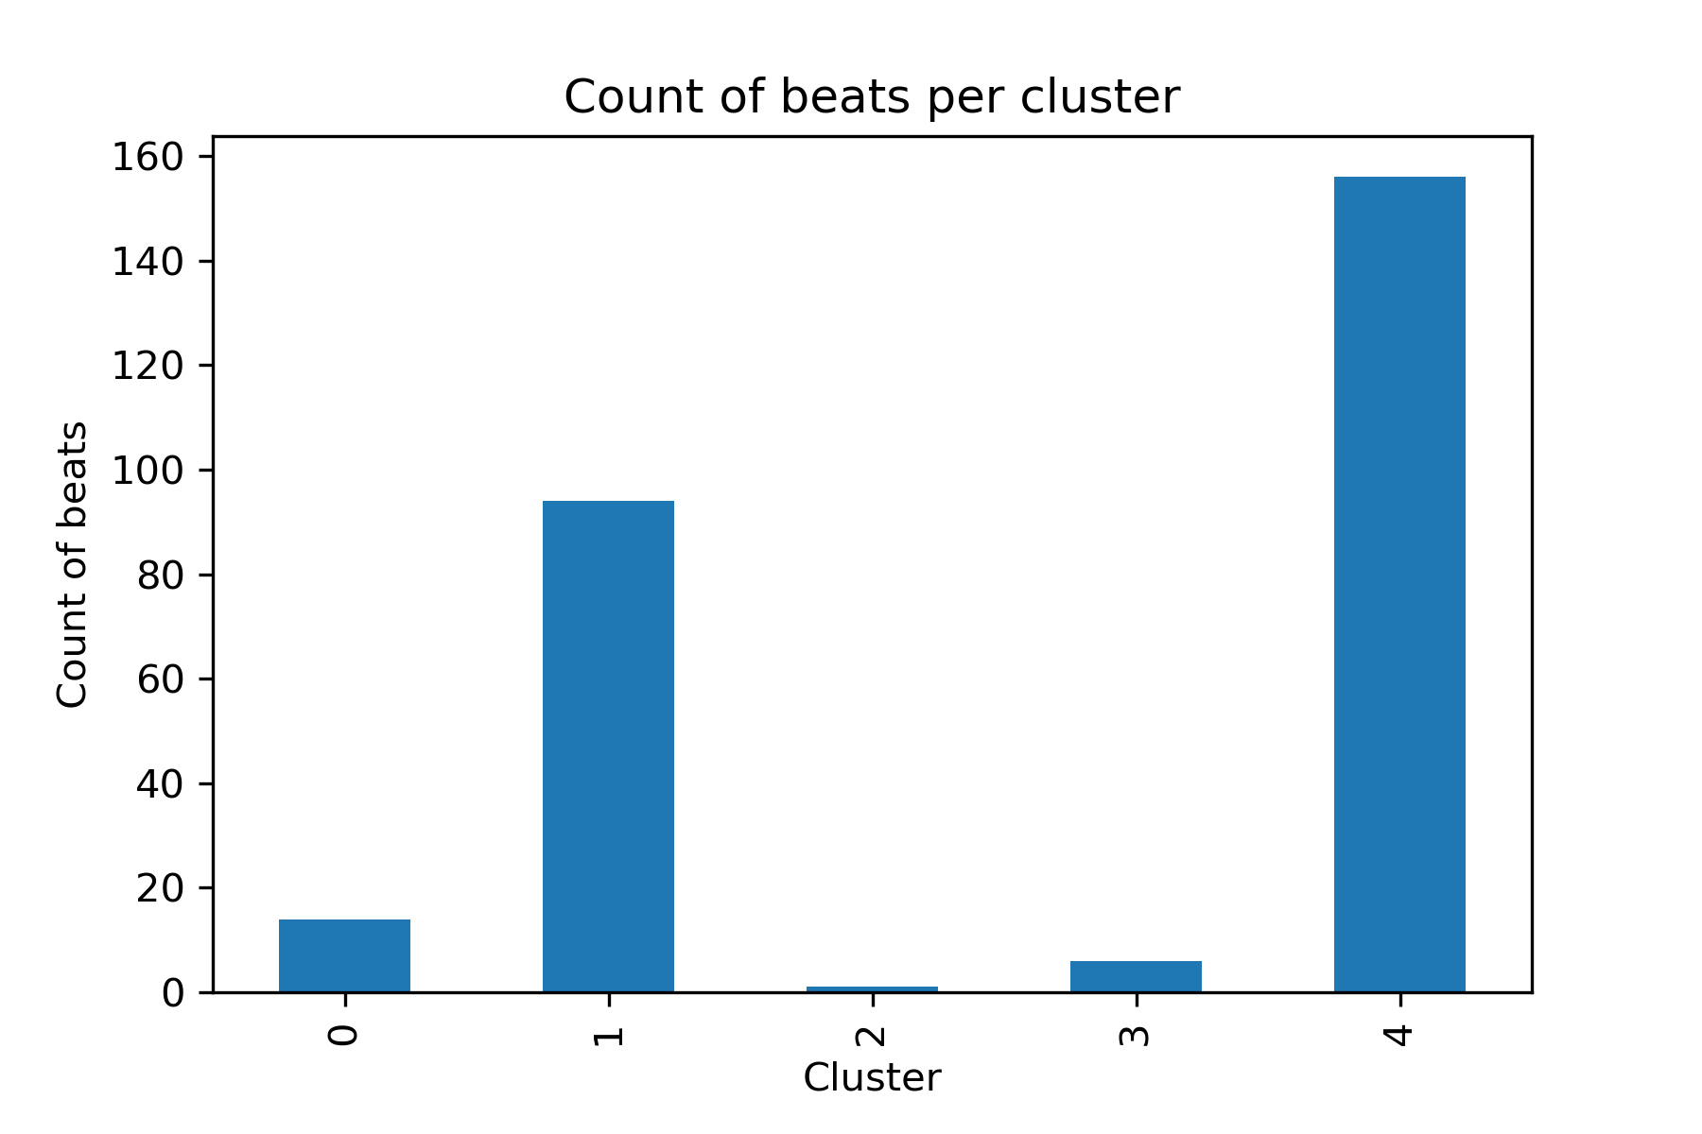
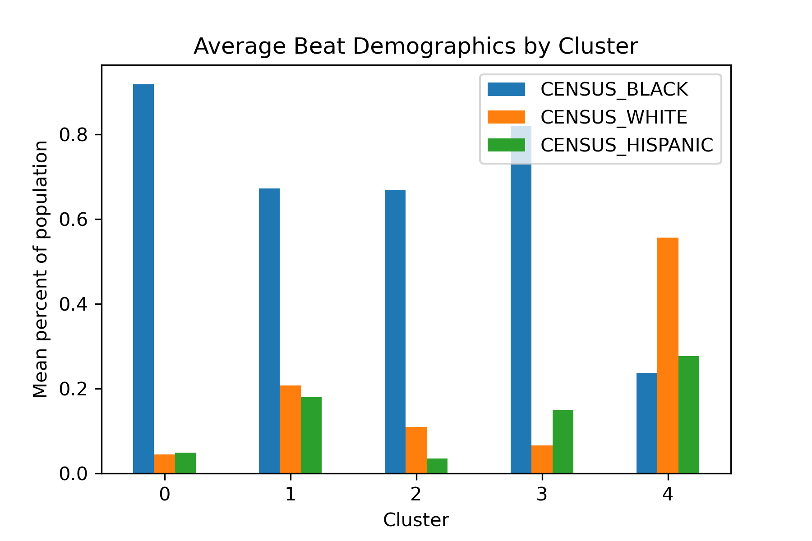
Evaluation and Results
Notes:
Eric

Slide 10
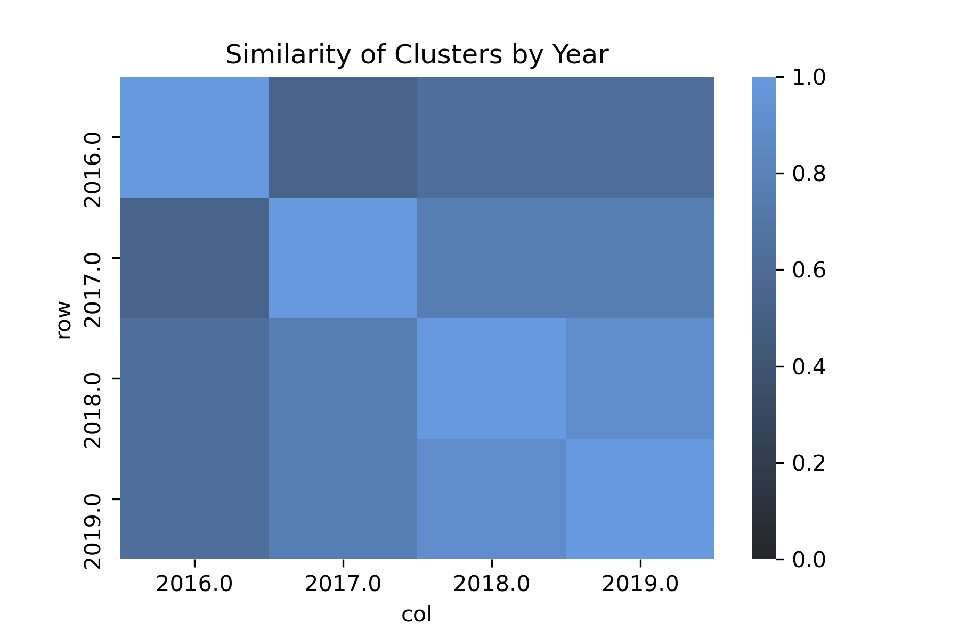
Evaluation and Results
How persistent are these clusters over time?
Notes:
Eric

Slide 11
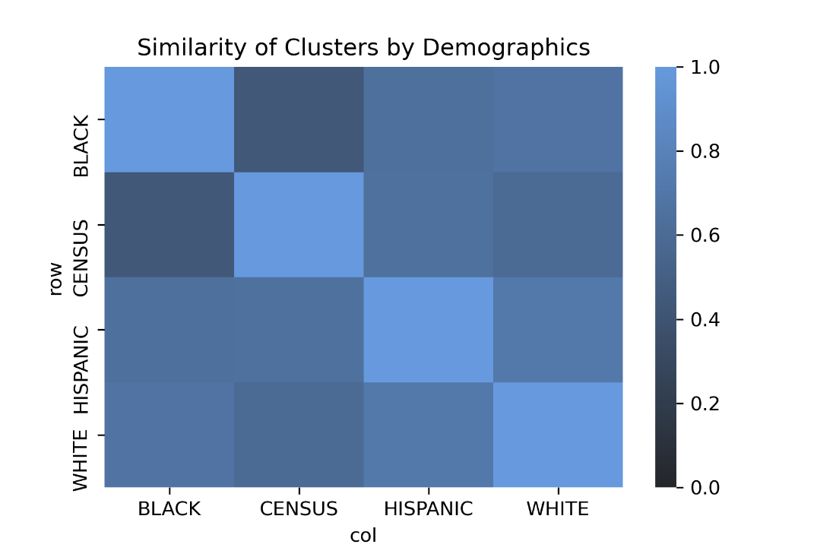
Evaluation and Results
How persistent are these clusters over different demographic groups?
Notes:
Eric

Slide 12
Policy Recommendations
Limited added value from clustering over linear observations
Identify outliers – which beats are exposed to disproportionate levels of police activity?
Further work:
[SOMETHING HERE]
Notes:
Jacob

Slide 13
Caveats and Limitations
Clustering is subjective – we have no labels!
Missing resident-initiated data from the same time period (e.g., 911 calls)
Aggregation level and feature selection may obscure relevant data
Clustering on (socially) biased data may yield biased results
Ethical concerns with labeling certain areas as “high-police-activity”
Notes:
Jacob

Slide 14
Extra

Slide 15
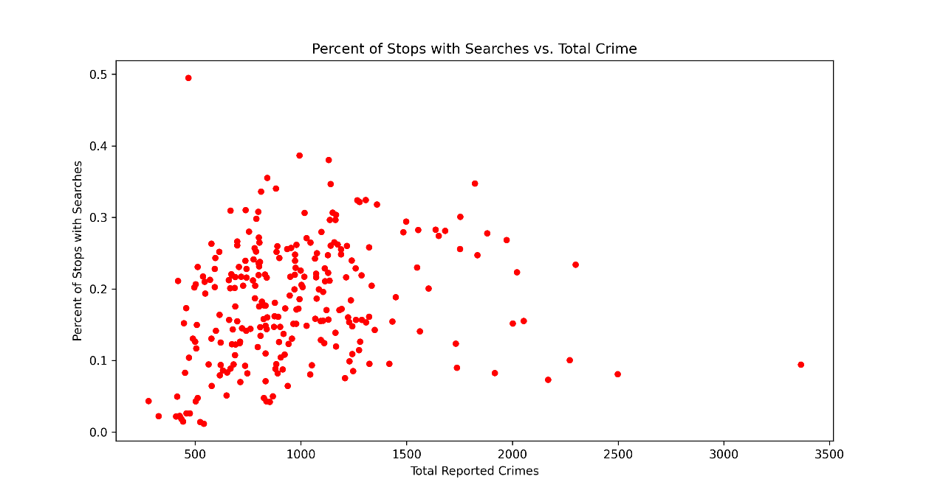
Do we have clustered data?

Slide 16
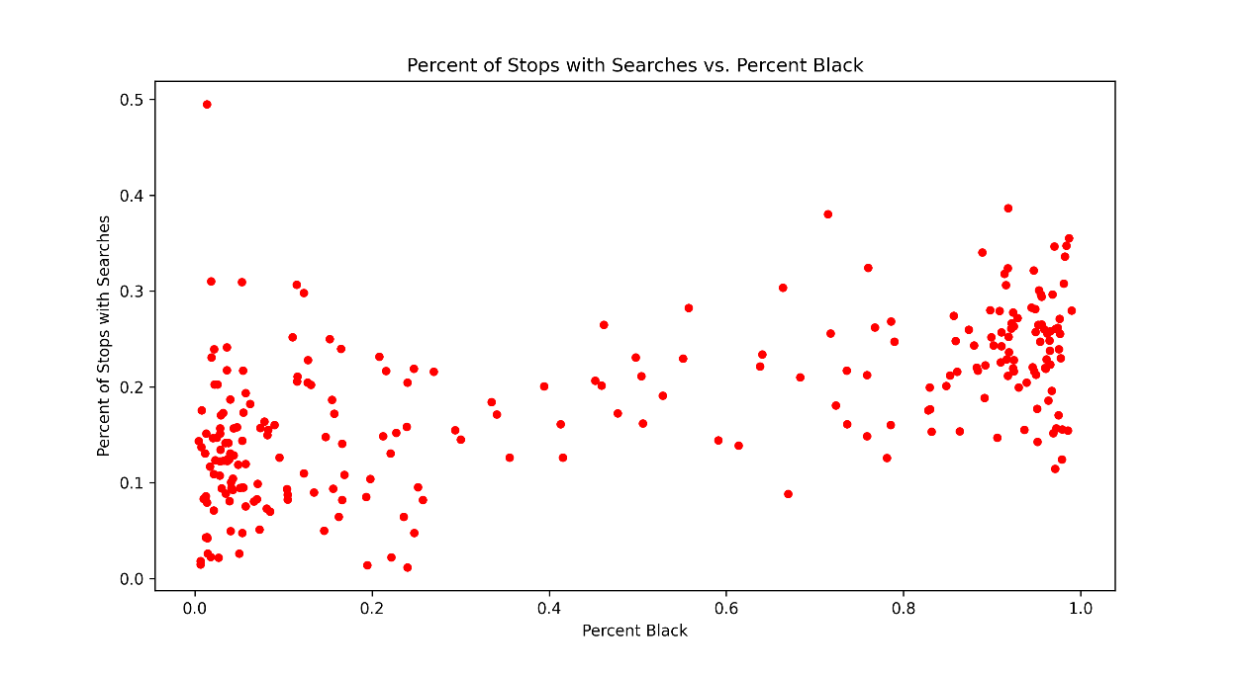
Do we have clustered data?

